Slide 1
JSC CTC Metallokonstruktsiya Corrugated structures

Slide 2
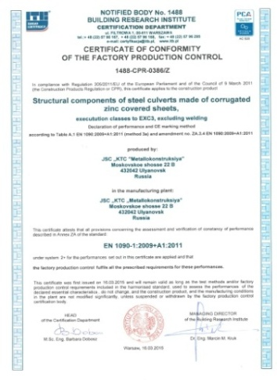
Corrugated Metal Structures (CMS)
A corrugated steel sheet (CSS) is lighter and stronger than a conventional steel sheet, and this advantage promises great potential for using CSS and prefabricated CSS-products – CMP (corrugated metal pipes) and CMS (corrugated metal structures) in engineering structures.
DOCUMENTATION
CTC Metallokonstruktsiya (Integrated Technical Center “Metal Structures”) produces corrugated metal structures in accordance with own specifications:
STO 05765820 001 2014;
STO 05765820 003 2014;
STO 05765820 004 2014; and
TU 5216 00205765820 2014,
generic designs 3.501.3 183 01, 3.501.3 185 03 and VSN 176 78, and customized designs.
CERTIFICATES
CMP APPLICATION
CMP are non-pressure pipes intended for installation of:
- Culverts on roads and railways;
- Environment-friendly corridors;
- Underground crosswalks;
- Sewer (discharge) pipes;
- Drain pipes;
- Storm drain collection tanks;
- Bulk storage tanks (silos);
- Formwork and
- Water wells.
STEEL USED FOR PRODUCTION
To produce CMP, steel grade 09Г2 is used, with hot-dip galvanized corrosion-resistant coating.
STO 05765820 004 2014 “CTC SMGK 130x32.5”
STO 05765820 003 2014 “CTC SMGK 150x50”
STO 05765820 001 2014 “CTC SMGK 381x142”
TU 5264 05765820 2012
Structural Elements of Corrugated Metal for Engineering Installations

Slide 3
DIAMETERS
CTC Metallokonstruktsiya produces a range of CMP diameters:
Corrugated Metal Pipes (CMP) with Goffer 130x32.5 | Corrugated Metal Pipes (CMP) with Goffer 150x50 | Corrugated Metal Pipes (CMP) with Goffer 381x142
From 1,000 to 3,500 (mm) | From 1,000 to 8,000 (mm) for pipes and arched structures of various shapes and sizes | From 8,400 to 15,120 (mm) for pipes and arched structures of various shapes and sizes
TECHNICAL PARAMETERS
Parameters of corrugated pipes produced by CTC Metallokonstruktsiya:
Pipe Profile | Goffer 130x32.5 for 1,000– 3,500 mm pipes (inclusive) | Goffer 150x50 for 1,000– 8,000 mm pipes (inclusive) and for arched structures of various shapes and sizes | Goffer 381x142 for 8,400–15,120 mm pipes (inclusive) and for arched structures of various shapes and sizes
Wall thickness (mm) | 2.5/3/4 | 2.5/3/4/5/6/7 | 5/6/7/8
Bearing capacity (depth of fill) | up to 10 m | up to 12 m | up to 12 m
Weight (l.m.) | With metal thickness 2.5 mm: d 1,000 mm – 92.6 kg d 1,500 mm – 137.95 kg d 2,000 mm – 175.53 kg | With metal thickness 2.5 mm: d 1,000 mm – 102 kg With metal thickness 3 mm: d 1,500 mm – 169.24 kg d 2,000 mm – 225.7 kg | With metal thickness 5 mm: d 8,400 mm – 1,880 kg d 10,200 mm – 2,280 kg d 15,120 mm – 3,270 kg
STO 05765820 004 2014 “CTC SMGK 130x32.5”
STO 05765820 003 2014 “CTC SMGK 150x50”
STO 05765820 001 2014 “CTC SMGK 381x142”
TU 5264 05765820 2012
Structural Elements of Corrugated Metal for Engineering Works

Slide 4
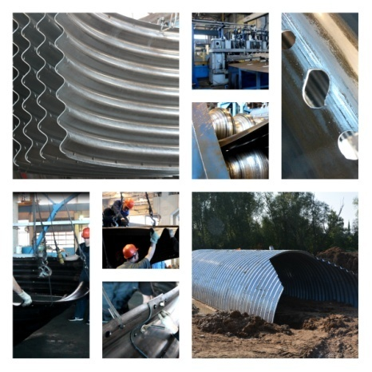
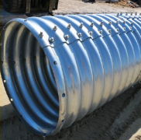
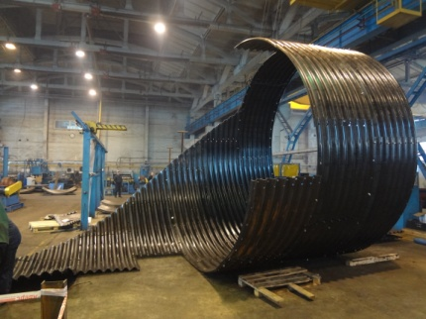
Corrugated Metal Structures (CMS)
CMP are supplied as separate sheets to be assembled into a pipe.
CMP are supplied as separate sheets with a cover of 910 or 1,170 (mm) | Sheets with a cover of 1,050 (mm) | Sheets with a cover of 1,143 (mm)
Table for Calculation of CMS with 130x32.5 mm Goffer
W, meters | Number of Elements, pcs | Sheet Width, mm | Weight per l.m., kg | Weight per ring, kg | Rings/meters per tonne of CMS | W, meters | Number of Elements, pcs | Sheet Width, mm | Weight per l.m., kg | Weight per ring, kg | Rings/meters per tonne of CMS
0.8 | 3 | 2.5 | 86 | 101 | 9.4/11.6 | 2 | 4 | 2.5 | 197 | 231 | 4.3/5.0
 |  | 3.0 | 102 | 119 | 8.4/9.8 |  |  | 3.0 | 233 | 273 | 3.6/4.3
 |  | 4.0 | 131 | 153 | 6.5/7.6 |  |  | 4.0 | 305 | 357 | 2.8/3.2
1 | 3 | 2.5 | 102 | 119 | 8.4/9.8 | 2.5 | 5 | 2.5 | 246 | 288 | 3.4/4.1
 |  | 3.0 | 120 | 140 | 7.1/8.3 |  |  | 3.0 | 291 | 341 | 2.9/3.4
 |  | 4.0 | 156 | 182 | 5.5/6.4 |  |  | 4.0 | 381 | 446 | 2.2/2.6
½ | 4 | 2.5 | 136 | 159 | 6.3/7.3 | 3 | 6 | 2.5 | 296 | 346 | 2.9/3.3
 |  | 3.0 | 160 | 187 | 5.3/6.2 |  |  | 3.0 | 350 | 409 | 2.4/2.8
 |  | 4.0 | 207 | 242 | 4.1/4.8 |  |  | 4.0 | 457 | 535 | 1.8/2.2
1.5 | 3 | 2.5 | 148 | 173 | 5.8/6.7
 |  | 3.0 | 174 | 204 | 4.9/5.7
 |  | 4.0 | 229 | 268 | 3.7/4.3
Table for Calculation of CMS with 150x50 mm Goffer
D, meters | Number of Elements, pcs | Sheet Width, mm | Weight per l.m., kg | Weight per ring, kg | Rings/meters per tonne of CMS | D, meters | Number of Elements, pcs | Sheet Width, mm | Weight per l.m., kg | Weight per ring, kg | Rings/meters per tonne of CMS
1.5 | 3 | 2,5 | 165 | 173 | 5.7/6.1 | 5 | 10 | 2.5 | 548 | 575 | 1.7/1.8
 |  | 3 | 191 | 200 | 5.0/5.3 |  |  | 3 | 633 | 665 | 1.5/1.6
 |  | 4 | 245 | 257 | 3.9/4.1 |  |  | 4 | 814 | 855 | 1.2/1.23
 |  | 5 | 298 | 313 | 3.2/3.4 |  |  | ⁵ | 922 | 1,042 | 0.9/1.0
 |  | 6 | 352 | 370 | 2.712.8 |  |  | 6 | 1,171 | 1,230 | 0.8/0.85
 |  | 7 | 410 | 430 | 2.3/2.4 |  |  | 7 | 1,350 | 1,417 | 0.7/0.73
2 | 4 | 2.5 | 219 | 230 | 4.3/4.6 | 5.5 | 11 | 2.5 | 603 | 633 | 1.6/1.76
 |  | 3 | 254 | 267 | 3.7/3.9 |  |  | 3 | 697 | 732 | 1.3/1.43
 |  | 4 | 326 | 342 | 2.9/3.1 |  |  | 4 | 895 | 940 | 1.0/1.1
 |  | 5 | 397 | 417 | 2.4/2.5 |  |  | 5 | 1,092 | 1,147 | 0.9/0.91
 |  | 6 | 469 | 492 | 2.0/2.1 |  |  | 6 | 1,290 | 1,354 | 0.7/0.8
 |  | 7 | 544 | 571 | 1.7/1.8 |  |  | 7 | 1,484 | 1,558 | 0.6/0.7
2.5 | 5 | 2,5 | 274 | 288 | 3.4/3.б | 6 | 12 | 2.5 | 657 | 690 | 1.4/1.5
 |  | 3 | 317 | 333 | 3.0/3.2 |  |  | 3 | 761 | 799 | 1.25/1.3
 |  | 4 | 407 | 427 | 2.3/2.5 |  |  | 4 | 977 | 1,026 | 0.9/1.0
 |  | 5 | 496 | 521 | 1.9/2.0 |  |  | 5 | 1,192 | 1,251 | 0.8/0.84
 |  | 6 | 586 | 615 | 1.6/1.7 |  |  | 6 | 1,407 | 1,477 | 0.7/0.73
 |  | 7 | 678 | 712 | 1.4/1.5 |  |  | 7 | 1,618 | 1,699 | 0.6/0.62
3 | б | 2.5 | 329 | 345 | 2.9/3.0 | 6.5 | 13 | 2.5 | 712 | 748 | 1.3/1.31
 |  | 3 | 381 | 400 | 2.5/2.6 |  |  | 3 | 824 | 865 | 1.2/1.21
 |  | 4 | 489 | 513 | 1.9/2.1 |  |  | 4 | 1,058 | 1,111 | 0.9/0.93
 |  | 5 | 596 | 626 | 1.6/1.7 |  |  | 5 | 1,291 | 1,356 | 0.7/0.8
 |  | 6 | 703 | 738 | 1.3/1.4 |  |  | 6 | 1,524 | 1,600 | 0.6/0.65
 |  | 7 | 812 | 853 | 1.2/1.2 |  |  | 7 | 1,752 | 1,840 | 0.5/0.57
3.5 | 7 | 2.5 | 384 | 403 | 2.5/2.7 | 7 | 14 | 2.5 | 767 | 805 | 1.2/1.34
 |  | 3 | 444 | 466 | 2.1/2.3 |  |  | 3 | 888 | 932 | 1.0/1.1
 |  | 4 | 570 | 598 | 1.6/1.7 |  |  | 4 | 1,140 | 1,197 | 0.8/0.9
 |  | 5 | 695 | 730 | 1.4/1.5 |  |  | 5 | 1,391 | 1,460 | 0.7/0.72
 |  | 6 | 821 | 862 | 1.2/1.3 |  |  | 6 | 1,646 | 1,723 | 0.6/0.62
 |  | 7 | 947 | 994 | 1.0/1.1 |  |  | 7 | 1,887 | 1,981 | 0.5/0.52
4 | 8 | 2.5 | 438 | 460 | 2.1/2.2 | 7.5 | 15 | 2.5 | 822 | 863 | 1.1/1.2
 |  | 3 | 508 | 533 | 1.9/2.0 |  |  | 3 | 951 | 999 | 1.0/1.1
 |  | 4 | 651 | 684 | 1.5/1.53 |  |  | 4 | 1,221 | 1,282 | 0.8/0.82
 |  | 5 | 794 | 834 | 1.2/1.3 |  |  | 5 | 1,490 | 1,564 | 0.6/0.7
 |  | 6 | 938 | 985 | 1.0/1.1 |  |  | ⁶ | 1,758 | 1,846 | 0.5/0.б
 |  | 7 | 1,081 | 1,135 | 0.9/0.92 |  |  | 7 | 2,021 | 2,122 | 0.4/0.5
4.5 | 9 | 2.5 | 493 | 518 | 1.9/2.0 | 8 | 16 | 2.5 | 876 | 920 | 1.1/1.2
 |  | 3 | 570 | 599 | 1.7/1.74 |  |  | 3 | 1,014 | 1,065 | 0.9/0.99
 |  | 4 | 732 | 769 | 1.3/1.4 |  |  | 4 | 1,303 | 1,368 | 0.7/0.77
 |  | 5 | 894 | 939 | 1.0/1.1 |  |  | 5 | 1,589 | 1,668 | 0.6/0.63
 |  | 6 | 1,055 | 1,108 | 0.9/0.94 |  |  | 6 | 1,875 | 1,969 | 0.5/0.54
 |  | 7 | 1,215 | 1,276 | 0.8/0.81 |  |  | 7 | 2,154 | 2,262 | 0.4/0.46
STO 05765820 004 2014 CTC SMGK 130x32.5”
STO 05765820 003 2014 CTC SMGK 150x50”
STO 05765820 001 2014 CTC SMGK 381x142”
TU 5264 05765820 2012
Structural Elements of Corrugated Metal for Engineering Installations

Slide 5
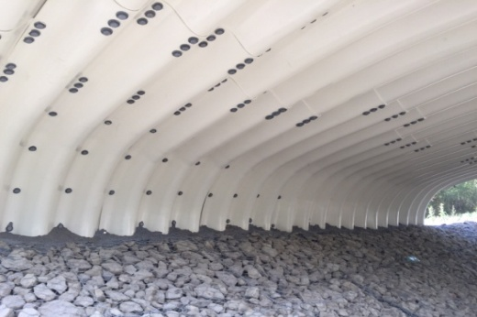
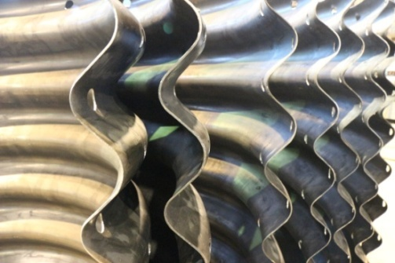
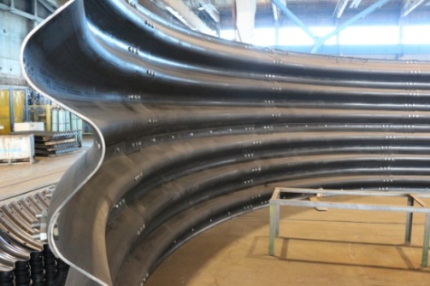
CORROSION RESISTANCE
The protective coating is applied in a proprietary zinc bath. The thickness of corrosion-resistant coating is at least 80 µm. The CMP production technology provides all necessary in-factory measures to protect metal from corrosion and mechanical damage through application of protective coating using hot-dip galvanization process.
ADVANTAGES OF PREFABRICATED CORRUGATED METAL STRUCTURES
Pipes and arches are assembled of radially bent steel sheets and then covered with soil. Metal casing in the form of corrugated sheet works together with the soil, which partially takes the load (compressive strain).
Corrugated metal structures help manufacture spans of significant length (up to 25 m). High reliability of CMS is combined with their economic efficiency. Corrugated structures do not take much time in assembly. Since they are assembled on site, this makes transportation easier and virtually removes the storage problem. No heavy construction equipment is required to assemble and erect the prefabricated corrugated metal structures; all assembly operations can be done manually.
When compared to reinforced concrete structures, the time required for assembly of CMS is 3–5 times less, whereas the costs are reduced up to 25%. Experience has proven that use of CMS instead of reinforced concrete helps save the facility budget by 15 - 20%.
Prefabricated corrugated metal structures can be used in any climate, even in the severest or the hottest one, since there is virtually no physical wear of CMS. With the minimum thickness of the metal in a corrugated metal structure, its flexibility and strength are reinforced with the backfill soil.
All the above helps cut down the maintenance costs for the facilities where corrugated metal structures are used. The service life of corrugated structures is as long as 100 years. And when necessary, they can be dismantled and re-used.
Table for Calculation of CMS with 381x142 mm Goffer
W, meters | Number of Elements, pcs | Sheet Width, mm | Weight per l.m., kg | Weight per ring, kg | Rings/meters per tonne of CMS | W, meters | Number of Elements, pcs | Sheet Width, mm | Weight per l.m., kg | Weight per ring, kg | Rings/meters per tonne of CMS
1.5 | 3 | 5 | 339 | 387 | 2.6/2.9 | 5.0 | 10 | 5 | 1,128 | 1,289 | 0.7/0.9
 |  | 6 | 402 | 460 | 2.2/2.5 |  |  | 6 | 1,341 | 1,533 | 0.6/0.7
 |  | 7 | 466 | 533 | 1.9/2.1 |  |  | 7 | 1,555 | 1,777 | 0.55/0.6
 |  | 8 | 529 | 605 | 1.6/1.9 |  |  | 8 | 1,768 | 2,021 | 0.5/0.56
2.0 | 4 | 5 | 451 | 516 | 1.9/2.2 | 5.5 | 11 | 5 | 1,240 | 1,418 | 0.7/0.8
 |  | 6 | 536 | 613 | 1.6/1.8 |  |  | 6 | 1,475 | 1,686 | 0.6/0.7
 |  | 7 | 622 | 711 | 1.4/1.6 |  |  | 7 | 1,710 | 1,955 | 0.5/0.6
 |  | 8 | 707 | 808 | 1.2/1.4 |  |  | 8 | 1,945 | 2,223 | 0.45/0.5
2.5 | 5 | 5 | 564 | 645 | 1.5/1.7 | 6.0 | 12 | 5 | 1,353 | 1,547 | 0.6/0.7
 |  | 6 | 671 | 767 | 1.3/1.5 |  |  | 6 | 1,610 | 1,840 | 0.5/0.6
 |  | 7 | 777 | 889 | 1.1/1.3 |  |  | 7 | 1,866 | 2,133 | 0.46/0.5
 |  | 8 | 884 | 1,010 | 1.0/1.1 |  |  | 8 | 2,121 | 2,425 | 0.4/0.47
3.0 | 6 | 5 | 677 | 774 | 1.3/1.4 | 6.5 | 13 | 5 | 1,466 | 1,676 | 0.6/0.7
 |  | 6 | 805 | 920 | 1.1/1.2 |  |  | 6 | 1,744 | 1,993 | 0.5/0.6
 |  | 7 | 933 | 1,066 | 0.9/1.1 |  |  | 7 | 2,021 | 2,310 | 0.4/0.5
 |  | 8 | 1,061 | 1,213 | 0.8/0.9 |  |  | 8 | 2,298 | 2,627 | 0.38/0.4
3.5 | 7 | 5 | 790 | 903 | 1.1/1.2 | 7.0 | 14 | 5 | 1,579 | 1,805 | 0.55/0.6
 |  | 6 | 939 | 1,073 | 0.9/1.1 |  |  | 6 | 1,877 | 2,146 | 0.46/0.5
 |  | 7 | 1,088 | 1,244 | 0.8/0.9 |  |  | 7 | 2,177 | 2,488 | 0.4/0.46
 |  | 8 | 1,238 | 1,415 | 0.7/0.8 |  |  | 8 | 2,476 | 2,830 | 0.35/0.4
4.0 | 8 | 5 | 902 | 1,031 | 0.9/1.1 | 7.5 | 15 | 5 | 1,692 | 1,934 | 0.5/0.6
 |  | 6 | 1,073 | 1,227 | 0.8/0.9 |  |  | 6 | 2,012 | 2,300 | 0.43/0.5
 |  | 7 | 1,244 | 1,422 | 0.7/0.8 |  |  | 7 | 2,332 | 2,666 | 0.37/0.4
 |  | 8 | 1,415 | 1,617 | 0.6/0.7 |  |  | 8 | 2,653 | 3,032 | 0.32/0.3
4.5 | 9 | 5 | 1,015 | 1,160 | 0.8/0.9 | 8 | 16 | 5 | 1,805 | 2,063 | 0.48/0.5
 |  | 6 | 1,207 | 1,380 | 0.7/0.8 |  |  | 6 | 2,146 | 2,453 | 0.4/0.46
 |  | 7 | 1,399 | 1,599 | 0.6/0.7 |  |  | 7 | 2,487 | 2,843 | 0.35/0.4
 |  | 8 | 1,591 | 1,819 | 0.5/0.6 |  |  | 8 | 2,829 | 3,234 | 0.3/0.35
STO 05765820 004 2014 “CTC SMGK 130x32.5”
STO 05765820 003 2014 “CTC SMGK 150x50”
STO 05765820 001 2014 “CTC SMGK 381x142”
TU 5264 05765820 2012
Structural Elements of Corrugated Metal for Engineering Installations

Slide 6
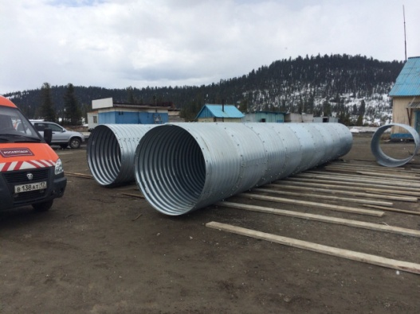
Corrugated Metal Structures (CMS)
SIMPLICITY AND EFFICINCY
Simple technology of CMS assembly is critical for reconstruction and repair of bridges. The existing small bridges as a rule have 12 – 18 m spans and can be replaced or restored using corrugated metal structures – conventional corrugated pipe or arch or any corrugated metal structure of a different modification.
At Metallokonstruktsiya plant corrugated metal structures (CMS) are manufactured at three production lines equipped with state-of-the-art equipment of foreign origin.
Classification of Engineering Installations Made of Prefabricated Corrugated Metal Structures (Some Types Only):
Radial closed structures |  | Round pipe with constant D (diameter) value | This type of structure is used when it is necessary to ensure passage of large flows in high embankments.
Radial arched structures |  | Round arch with constant R (radius) value | This type of structure is used when it is necessary to construct bridges or crossovers in high embankments with a large carrying capacity.
Box-type structures |  | Small-span lower-section arched structure with a cross section of two or more radii | This type of structure is used when it is necessary to construct bridges or crossovers in small embankments.
Medium-sized polycentric structures |  | Middle-span arched structure with a cross section of two or more radii | This type of structure is used when it is necessary to construct bridges or crossovers.
Large polycentric structures |  | Large-span arched structure with a cross section of two or more radii | This type of structure is used when it is necessary to construct bridges or crossovers.
STO 05765820 004 2014 “CTC SMGK 130x32.5”
STO 05765820 003 2014 “CTC SMGK 150x50”
STO 05765820 001 2014 “CTC SMGK 381x142”
TU 5264 05765820 2012
Structural Elements of Corrugated Metal for Engineering Installations

Slide 7
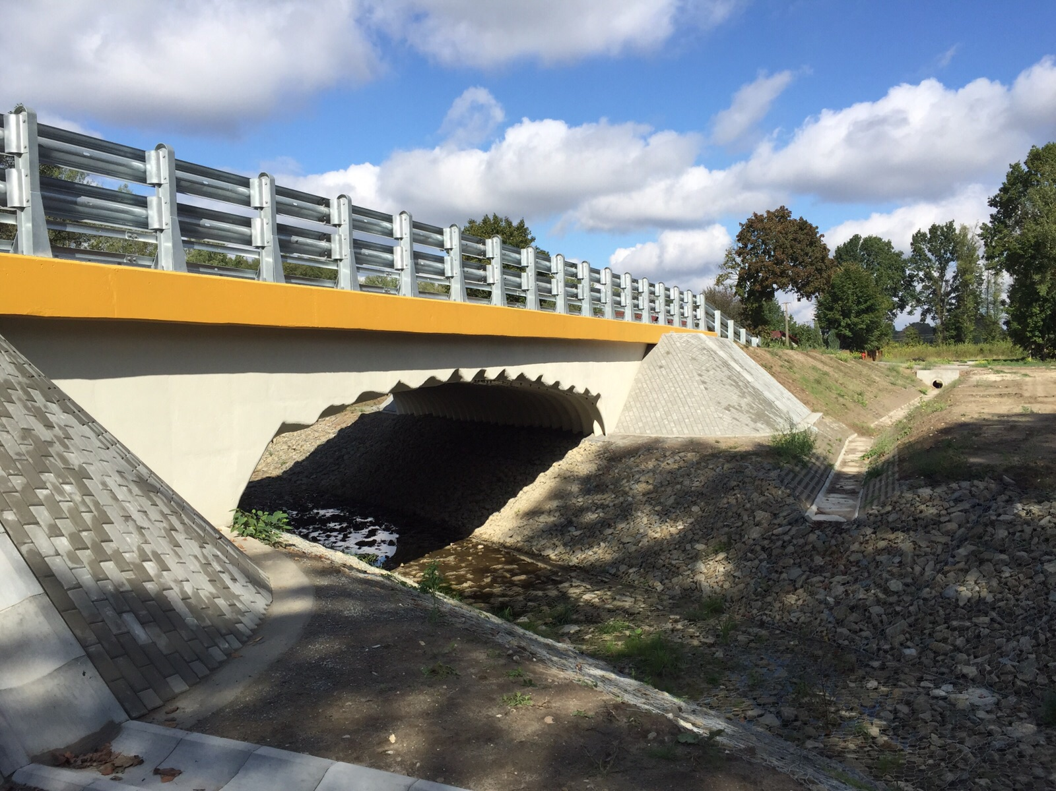
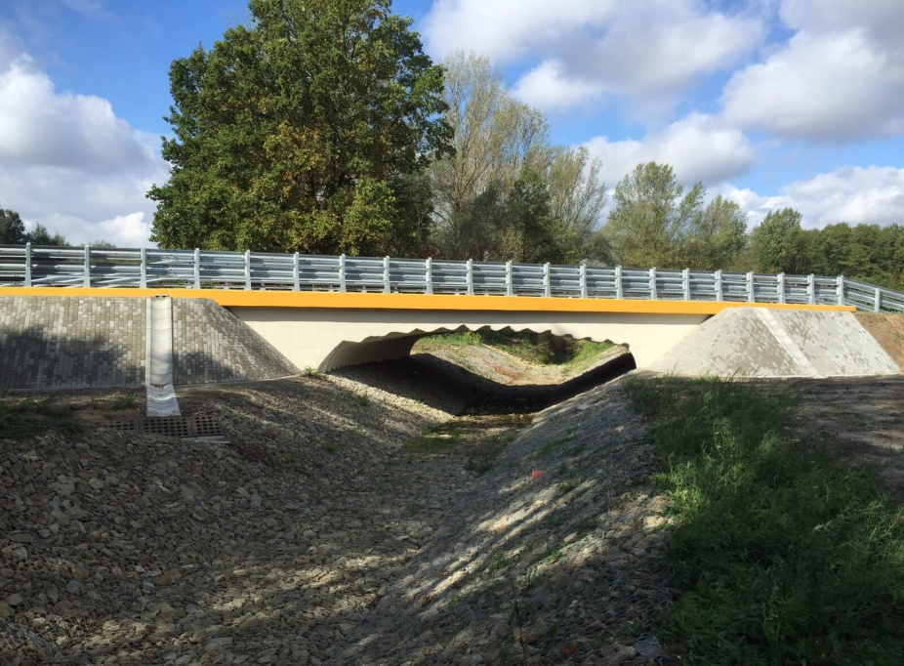
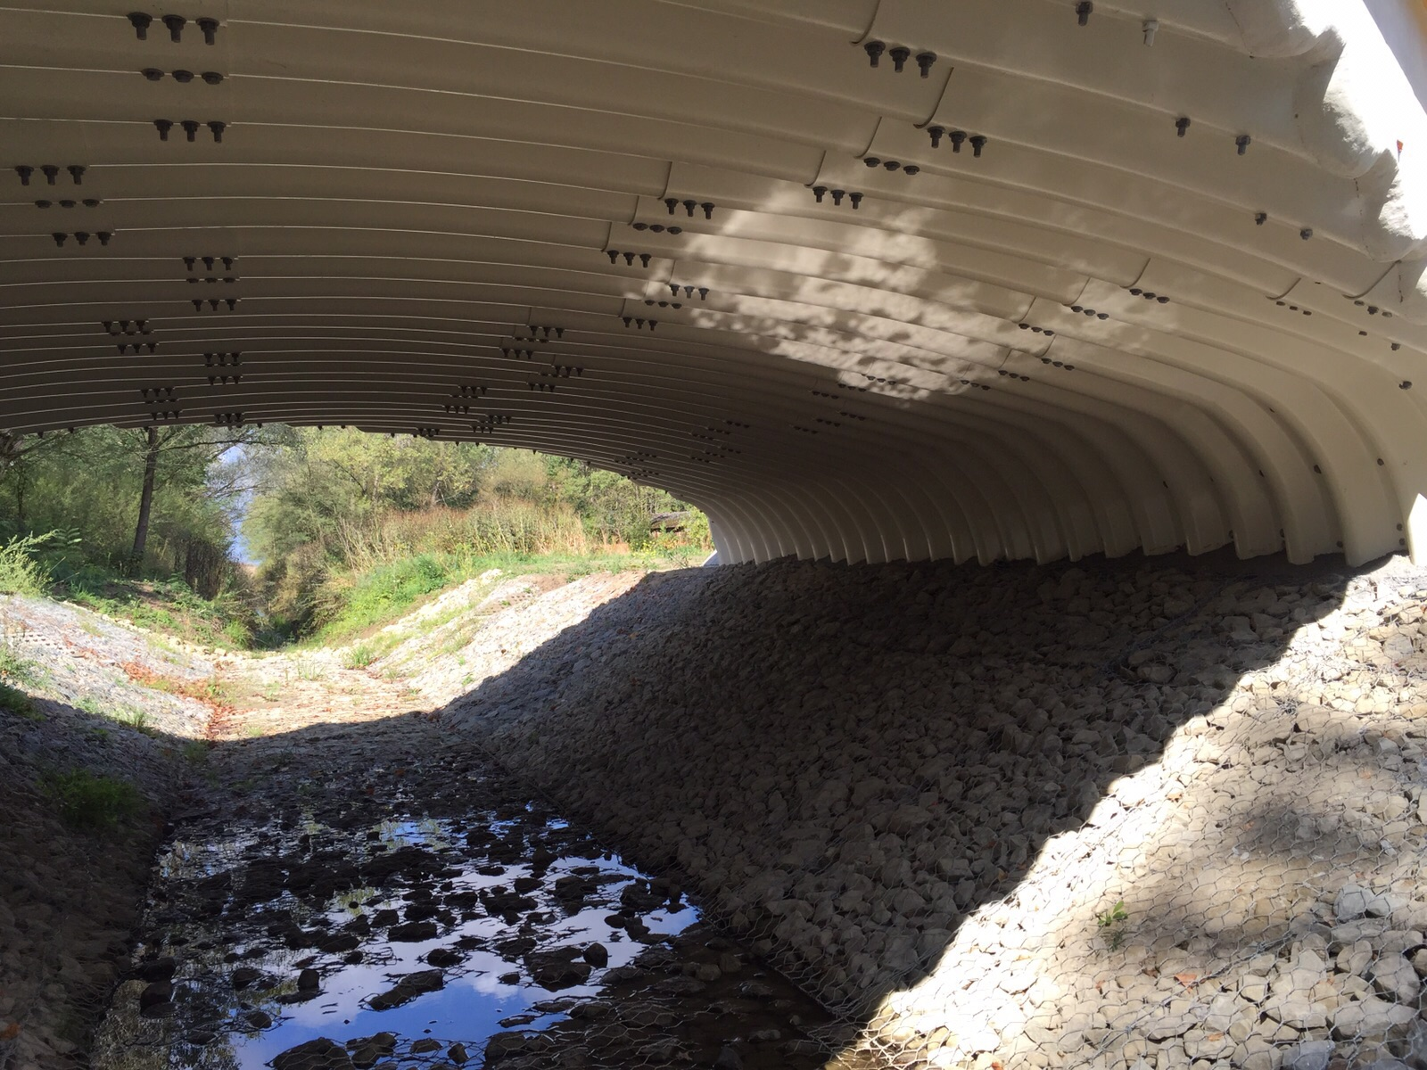

Slide 8
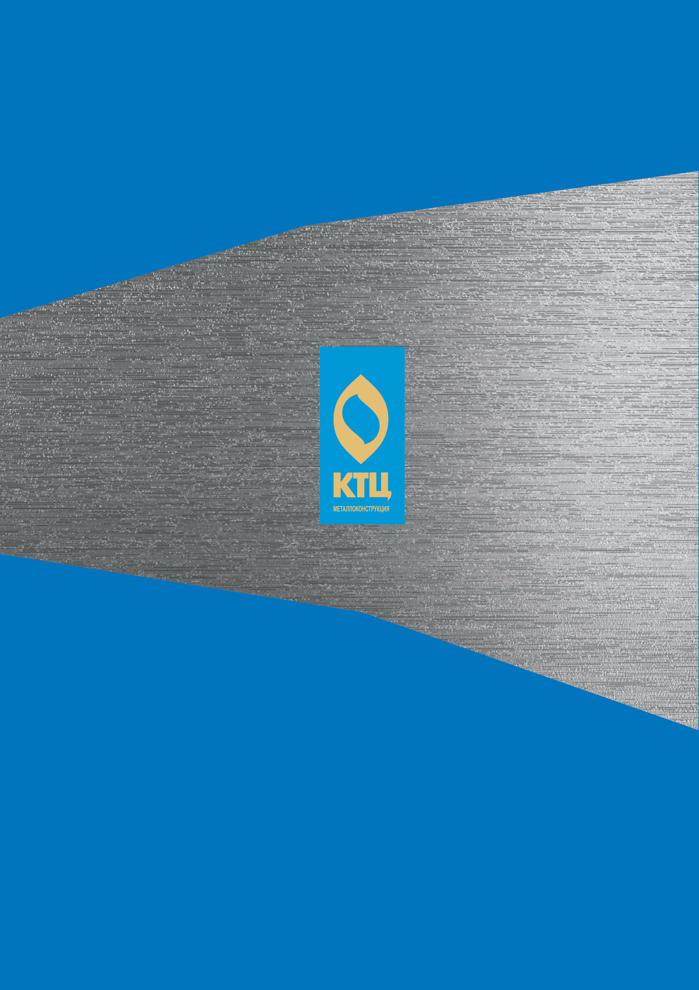
JSC “CTC “Metallokonstruktsiya”
Russia, Ulyanovsk, Moskovskoye shosse, 22B
tel.: +8 (8422) 407199 (90)
e-mail: info@ktc.ru

